Slide 1

Where Are We in The Credit Cycle?
Edward I. Altman
And
Global Zombies Companies – Measurements, Determinants and Outcomes
Edward I. Altman, Rui Dai, and Wei Wang
1
Notes:
screenshots

Slide 2
Where Are We Now in the Credit Cycle?
Edward I. Altman
NYU Stern School of Business
And
Co-Founder, Wiserfunding Ltd.

Slide 3
Global Sectoral Indebtedness
$ Trillion and % GDP
Year | % of GDP | Total $ Amt. ($ T)
1997 | 217% | 70
2007 | 278% | 162
2017 | 317% | 233
2018 | 319% | 243
2019 | 322% | 253
2020 | 336% | 282
2021 | 350% | 303
2022 | 337% | 299
Sources: Chart from Independent UK using IIF, BIS, IMF and Haver data for 1997 and 2007. Data for 2017, 2018, 2019, 2020, 2021, and 2022 from “Global Debt Monitor”, Institute of International Finance, March 26, 2023.
Notes:
Source: https://www.iif.com/Key-Topics/Debt/Monitors

Slide 4
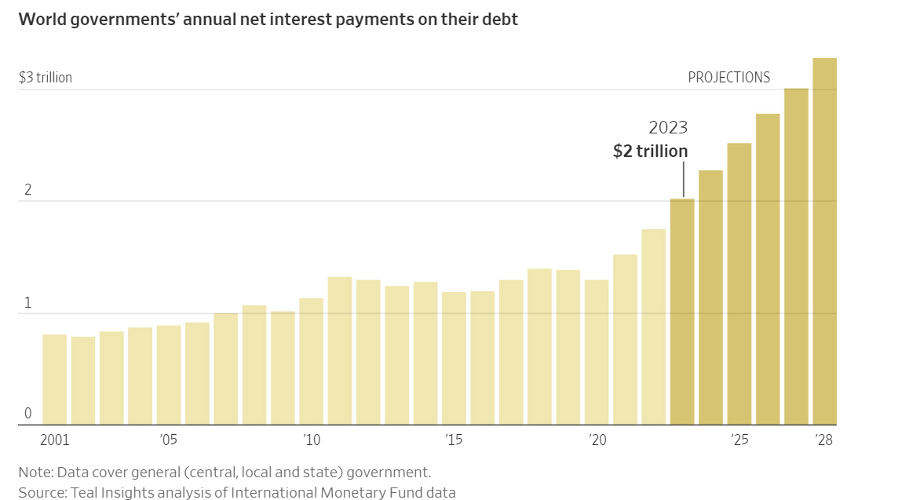

Slide 5
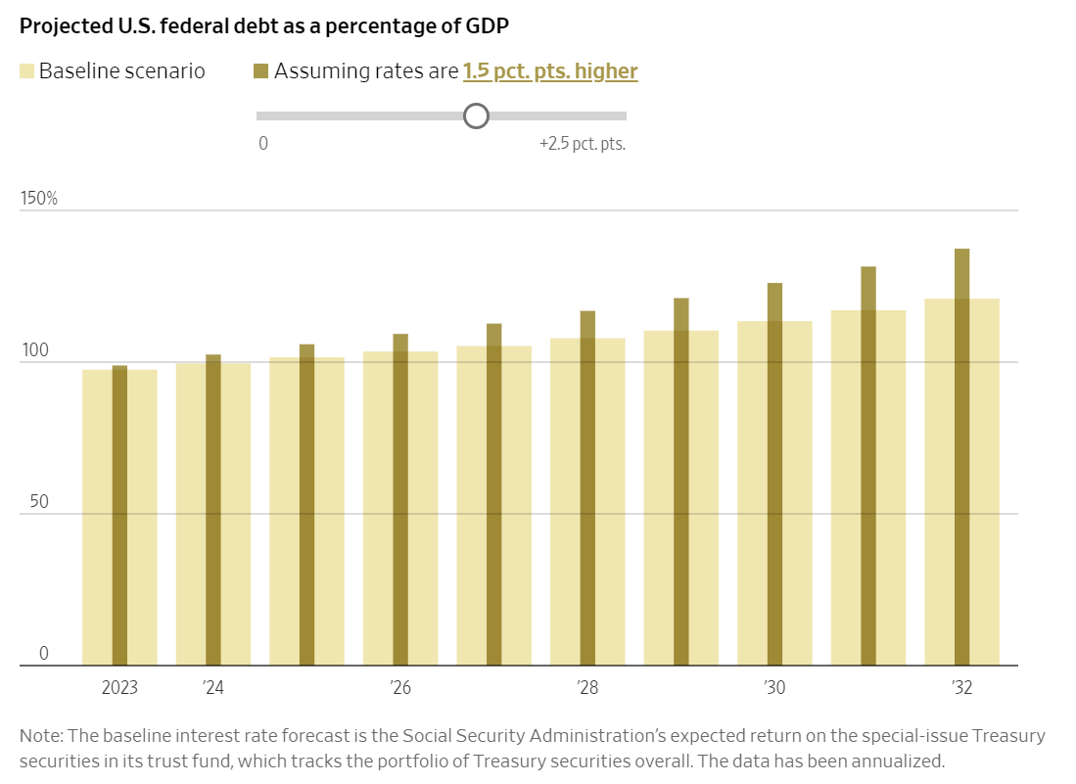
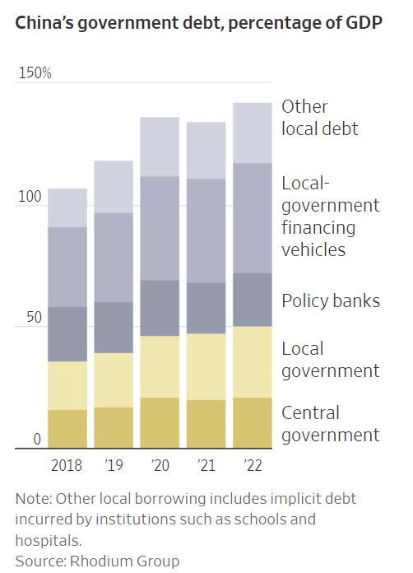

Slide 6
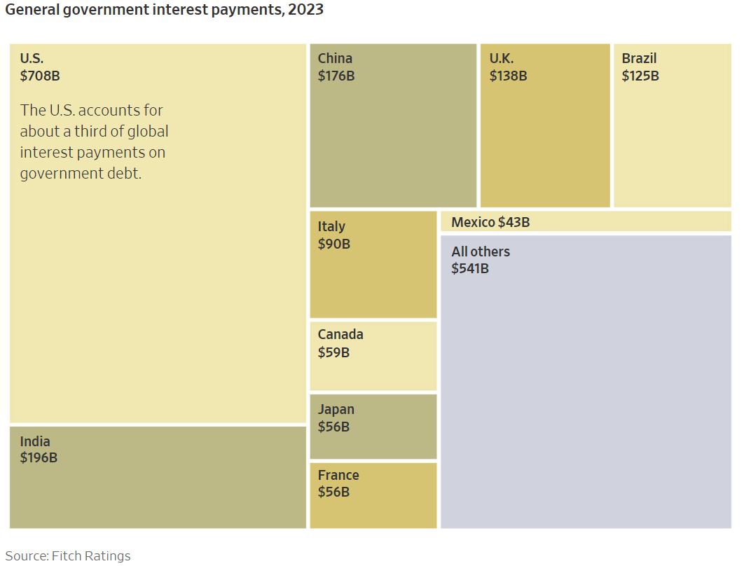
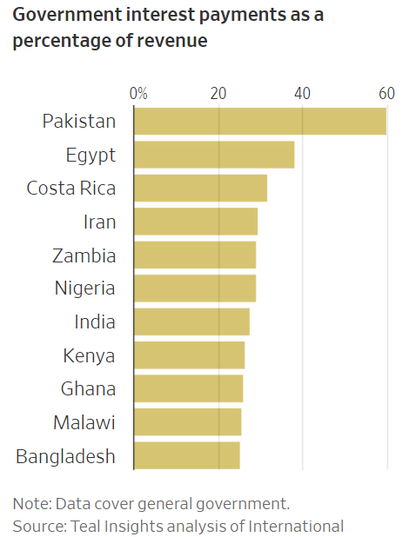

Slide 7
US government interest payments per day have doubled from $1 bn per day before the pandemic to almost $2 bn per day in 2023
Sources: CBO, Haver Analytics, Apollo Chief Economist.

Slide 8
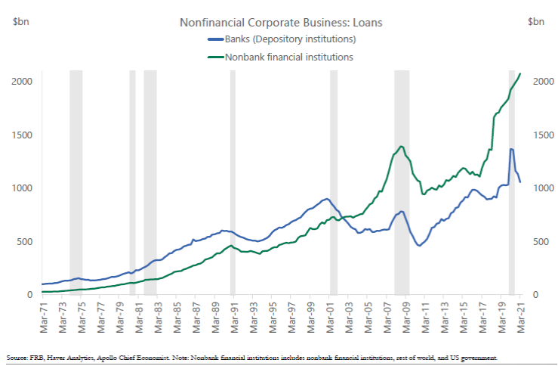
Sources of financing for nonfinancial corporate businesses
8

Slide 9
Credit Cycle Indicators and Outlook for 2024
Indicators | Historical Average (1971 – 2022) | December 31,2023 (Full-Year Results)**
Default Rates – HY Bonds Forecast for 2024 | 3.3% — | 3.4% ($ Based); 4.0% (Issuer) 3.2% ———> 4.2% ($ Based)
Default Rates Leveraged loans Forecast for 2024 | 2.5% — | 3.5% ($ Based); 5.8% (Issuer) 3.4% ——-> 4.5% ($ Based)
Recovery Rate - HY Bonds Forecast for 2024 | 45% — | 36.0% ($ Based); 39.0% (Issuer) 43% ————> 36% ($ Based)
Recovery Rate - Lev Loans Forecast for 2024 | 60.0% — | 50.0% ($ Based); 52.0% (Issuer) 55.0% ($ Based); 58% (Issuer)
Investor Required Rates of Return | 5.4% (OAS) 5.3% (YTMS) | 3.40% (OAS) 3.60% (YTMS)
High Yield Bond Distress Ratio (Percent of HY Bonds > 10% above T-Bond) | 8% | 6%
HY Bond Market Liquidity (New Issue Amount) CCC New Issue Percent | ~$200-$250Bn (2015-2022) 12-15% | $175 Bn 5%
Default Rate Direct Lending (Shadow Banks) | — | 2.10% (*) (Issuer)
*Source: Eric Rosenthal (KBRA)
**Note: As of 3/31/2024, the YTD high yield default rate was 0.6% (8 defaults), the leveraged loan default rate was 2.0% (25 defaults); the latter is a record quarterly rate.
Sources: E. Altman (NYU Stern); E. Rosenthal (KBRA) (*)
9

Slide 10
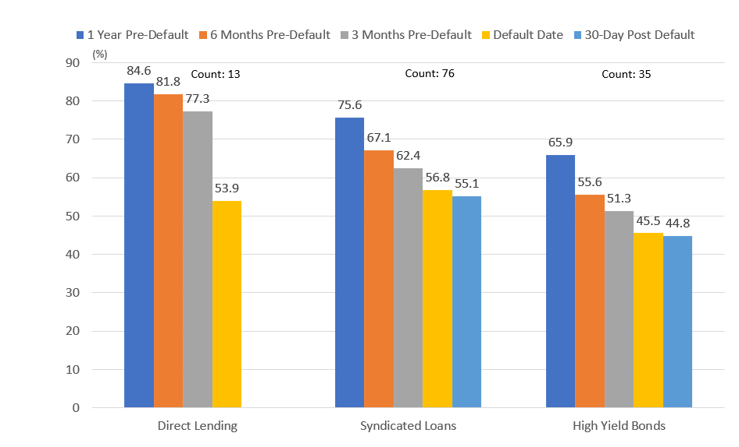
Pre and Post Default Recovery Rates for Direct Debt Lending, Syndicated Loans and High-Yield Bonds, Last Twelve Months As Of 3/31/24
Source: E. Rosenthal (KBRA)

Slide 11
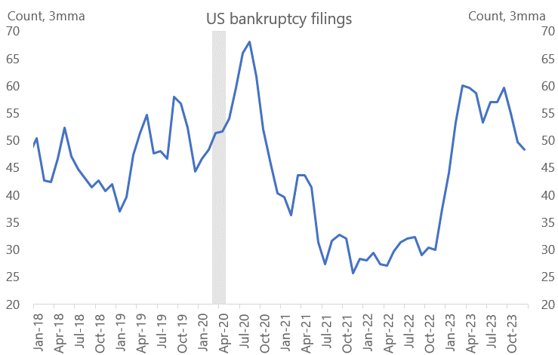
Bankruptcies rising because of Fed hikes
Source: Apollo Chief Economist

Slide 12
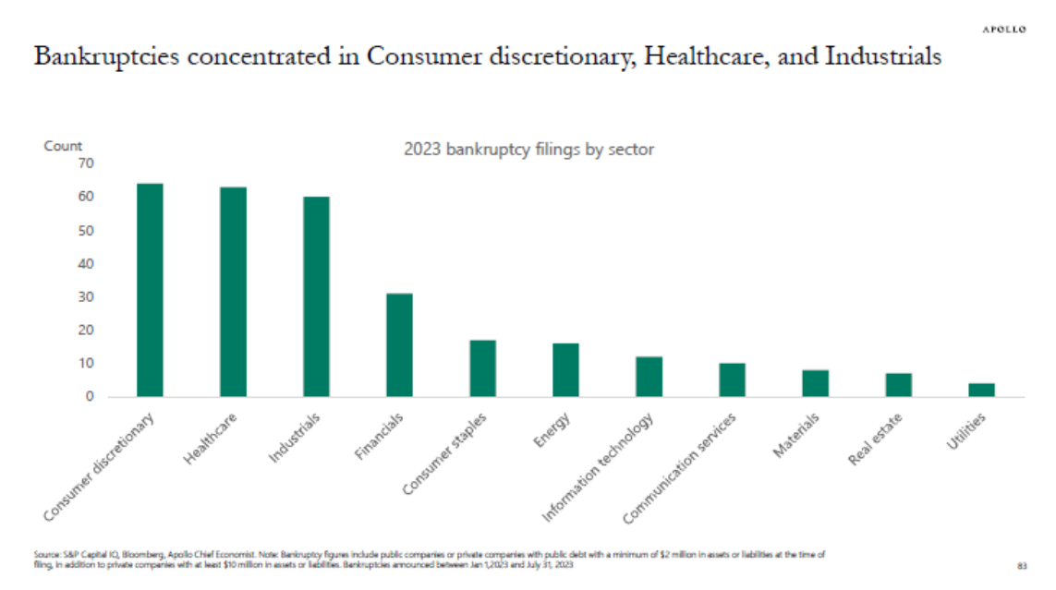
Source: Apollo Chief Economist

Slide 13
High Yield Bond Spread (OAS, Option-Adjusted)
Avg = 5.45%
Current = 3.42% (04/17/2024)
13
Sources: FRED, Federal Reserve Bank of St. Louis

Slide 14
High Yield Bonds New Issue Volume
Sources: Bank of America

Slide 15
Forecasting 2024 HY Bond Default Rate
Key Variables in the Forecast
Mortality Rate Technique
Yield Spread – Risk Premium Technique
Distressed Ratio Technique
Main Unknowns are US GDP Default Rate (Recession in 2024?) and Geo Political Risk.
Resulting In
3.2———> 4.2%
15

Slide 16
Default Rates, Distressed Debt Returns and the Credit Cycle

Slide 17
Historical Default Rates, Benign Credit Cycles and Recession Periods in the U.S.
High-Yield Bond Market Default Rate (1972 – 2024)
Default
Rates
Forecast
– 5 yrs –
– 7 yrs –
– 7 yrs –
– 4 yrs –
– 11 yrs –
2-3
yrs
Average Annual
Default Rate
24
Recession Length:
16mos
6mos
16mos
8mos
8mos
18mos
2mos
12mos
Note: The highlighted areas show Periods of Recession. Periods of Recession are as follows: 11/73 – 3/75, 1/80 – 7/80, 7/81 – 11/82, 7/90 – 3/91, 4/01 – 12/01, 12/07 – 6/09, 2/20 – 4/20, 1/23 – 12/23. 1/23 - 12/23 is a forecast rather actual. Benign credit cycles are approximated. All rates are annual.
Source: E. Altman (NYU Salomon Center); National Bureau of Economic Research
17
Notes:
2022 default rate – 1.5%
2023 default rate – 3.3%
2024 default rate – 6.6%

Slide 18
Historical Default Rates, Benign Credit Cycles and Recession Periods in the U.S.
High-Yield Bond Market Default Rate (1972 – 2024)
Default
Rates
Forecast
– 5 yrs –
– 7 yrs –
– 7 yrs –
– 4 yrs –
– 11 yrs –
2-3
yrs
?
Average Annual
Default Rate
24
Recession Length:
16mos
6mos
16mos
8mos
8mos
18mos
2mos
12mos
Note: The highlighted areas show Periods of Recession. Periods of Recession are as follows: 11/73 – 3/75, 1/80 – 7/80, 7/81 – 11/82, 7/90 – 3/91, 4/01 – 12/01, 12/07 – 6/09, 2/20 – 4/20, 1/23 – 12/23. 1/23 - 12/23 is a forecast rather actual. Benign credit cycles are approximated. All rates are annual.
Source: E. Altman (NYU Salomon Center); National Bureau of Economic Research
18
Notes:
2022 default rate – 1.5%
2023 default rate – 3.3%
2024 default rate – 6.6%

Slide 19
Positive and Negative Credit Cycle Factors
Positive Factors
Continuing Robust Corporate Earnings
Average Forecasted Default and Recovery Rates about Historical Average
Slightly Decreasing Inflation Rate (US and Europe)
“No Landing” ? - Positive or Negative for Capital Markets?
Golub Capital Altman Index – Middle Market
Negative Factors
Waterfall (Refinancing) Analysis
High Interest Rates
High Inflation Rates
Likely Recession?
Major Liquidity Concerns
Increasing Default Rates in 2022 and 2023
Increase in Credit Risk, 2019 vs 2022 based on Z Score Analytics
19

Slide 20
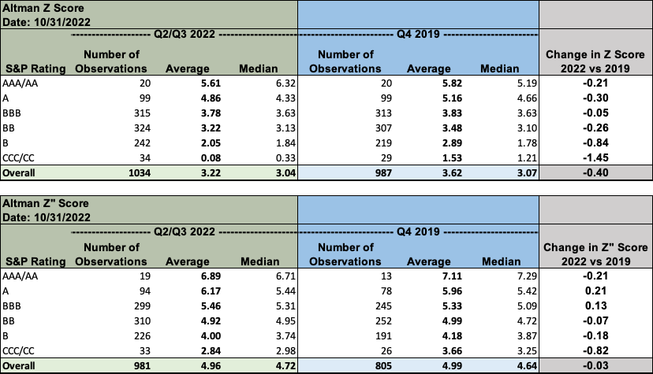
Comparing Z-Scores:2019 vs 2022
Source: Author’s calculations from Bloomberg.

Slide 21
Firms Whose Z and Z” scores had a bond rating equivalent of Below triple B- in 2023:
59 % in 2023 vs 34% in 2019
2023 59%
2019 34%

Slide 22
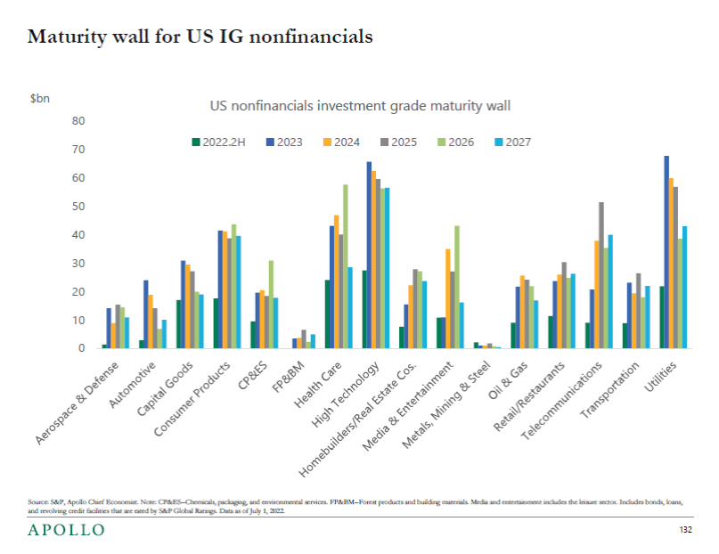
22

Slide 23
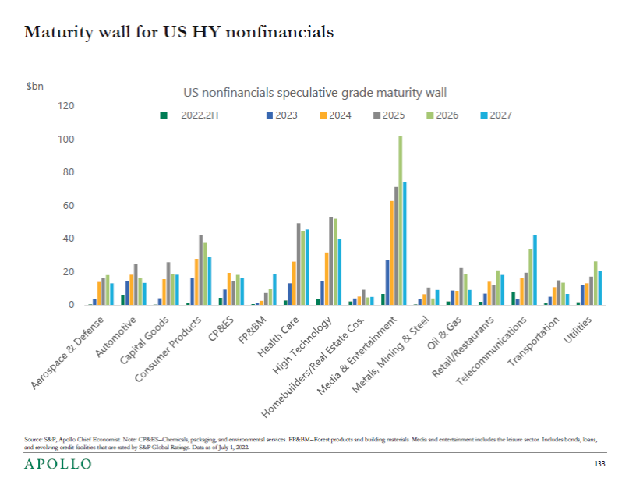
~$155Bn
23

Slide 24
Chapter 11 Bankruptcies in 1st Quarter (2018-2024)
Year | Jan | Feb | March | Total
2018 | 346 | 396 | 751 | 1493
2019 | 351 | 643 | 429 | 1423
2020 | 617 | 525 | 509 | 1651
2021 | 465 | 406 | 368 | 1239
2022 | 211 | 188 | 285 | 684
2023 | 364 | 362 | 574 | 1273
2024 | 455 | 813 | 598 | 1866
Conclusion
2024 is a 47% increase over 2023
2024 is a 13% increase over 2020
2024 is a 36% increase over the average for 2018 - 2024

Slide 25
A Shift in The Credit Cycle?
Recent Changes and Key Factors in Risky Debt Markets
(As of March 31, 2024 )
CONCLUSION:
The credit cycle indicators are essentially mixed in their outlook: A few (3) indicate lower than average credit risk in 2024 (Investor Required Rates of Return, Distress Ratios and Liquidity), one indicates higher credit risk outlook (Recovery Rates) and one (Default Rates) are about at the historical average, But, the TREND in default rates over the last three years indicate a potential spike in credit risk, especially if the economy does not grow much, or at all, in 2024, or if unknown major risks materialize.
Q1 2024 Chapter 11 bankruptcies at the highest level since the GFC, with total filings up 47% over 2023 and 13% higher than the next highest year in 2020. There was also a spike in sub-chapter V of Chapter 11 relevant to smaller firms with liabilities less than 7.5M.
25
Notes:
Yield on CCC bonds: https://ycharts.com/indicators/us_high_yield_ccc_effective_yield#:~:text=Basic%20Info,long%20term%20average%20of%2014.18%25.

Slide 26
Global Zombies: Global Zombies Companies: Measurements, Determinants
and Outcomes
Edward I. Altman, Rui Dai, and Wei Wang
26
Notes:
screenshots

Slide 27
WHAT IS A ZOMBIE FIRM?
Insolvent Firm That is Still Functioning over a Relatively Long Time Period
What Are Appropriate Measures of Zombie Firms?
For How Long?
How Are Zombie Firms Supported? And by Whom?
27

Slide 28
OUR STUDY PROPOSES AND ANALYSES
What Are The "CONS" (Negatives) of Zombie Firms For An Economy?
What are the "PROS" (Positives) of Zombie Firms For An Economy?
How Best to Measure Zombie Firms?
What Have Been The Trends Of Zombie Firms Over The Last 30 Years Globally And For Specific Countries?
What Are The Major Determinants of The Percentage of Listed Zombie Firms In An Economy And Across Different Countries Over Time?
28

Slide 29
OUR SUGGESTED MEASURES OF ZOMBIE FIRMS
Firms With Cash Flow Interest Expense Coverage (IC= EBITDA/Interest) < 1.0, Based On A 3-Year Moving Average
AND
Firms With A Clear, Very High Probability of Default, Also Based On A 3-Year Moving Average, Using Z-Scores or Z":-Scores
29

Slide 30
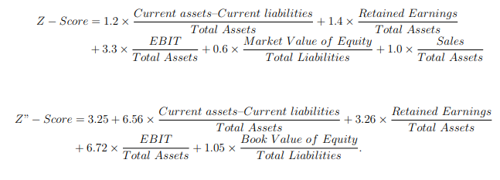
Z and Z" Score Models
30

Slide 31
Comparing Interest Coverage Zombie Ratios to the Dual-Filter Approach: Global and USA
 | Global |  |  |  |  | USA
 | Listed Public Firms |  |  |  |  | Listed Public Firms
 | Means |  |  |  |  | Means
year | EBITDA/ Interest | Z-Score | Z"-Score | EBITDA/ INT& Z-Score | EBITDA/ INT & Z"-Score | EBITDA/ Interest | EBITDA/ INT & Z-Score | EBITDA/ INT & Z"-Score
1990 | 6.58% | 1.61% | 1.65% | 1.42% | 1.44% | 23.38% | 5.53% | 7.60%
1991 | 7.23% | 1.69% | 1.61% | 1.52% | 1.33% | 22.83% | 5.04% | 7.04%
1992 | 8.37% | 1.78% | 1.81% | 1.64% | 1.58% | 21.48% | 3.64% | 6.07%
1993 | 10.14% | 2.29% | 2.09% | 2.13% | 1.82% | 21.47% | 3.15% | 5.59%
1994 | 11.09% | 2.08% | 2.02% | 1.80% | 1.59% | 20.88% | 3.53% | 5.99%
1995 | 9.31% | 1.49% | 1.78% | 1.02% | 1.32% | 20.87% | 3.21% | 6.07%
1996 | 8.85% | 1.50% | 1.76% | 1.27% | 1.47% | 22.76% | 3.43% | 6.53%
1997 | 9.31% | 1.94% | 2.44% | 1.75% | 2.13% | 23.96% | 4.33% | 7.44%
1998 | 12.84% | 3.76% | 3.60% | 3.25% | 3.06% | 22.76% | 4.70% | 7.28%
1999 | 15.18% | 4.42% | 4.60% | 3.87% | 3.78% | 23.82% | 4.18% | 6.88%
2000 | 17.60% | 6.09% | 6.30% | 5.40% | 5.36% | 27.87% | 6.07% | 8.94%
2001 | 20.00% | 7.05% | 7.26% | 5.98% | 6.07% | 26.77% | 5.99% | 8.97%
2002 | 21.35% | 8.31% | 8.33% | 6.67% | 6.70% | 26.28% | 8.54% | 10.16%
2003 | 20.57% | 8.85% | 8.85% | 6.84% | 6.85% | 22.96% | 7.16% | 9.57%
2004 | 18.11% | 7.95% | 8.42% | 5.99% | 5.96% | 20.76% | 7.09% | 8.60%
2005 | 16.93% | 7.53% | 7.85% | 5.31% | 5.39% | 18.62% | 6.12% | 8.20%
2006 | 15.06% | 6.15% | 7.21% | 4.25% | 4.83% | 18.54% | 6.01% | 8.16%
2007 | 14.23% | 5.01% | 6.39% | 3.44% | 4.44% | 20.16% | 6.91% | 8.61%
2008 | 16.34% | 5.73% | 6.56% | 4.34% | 4.54% | 19.57% | 7.97% | 9.40%
2009 | 17.66% | 6.94% | 7.19% | 5.39% | 5.30% | 18.26% | 7.37% | 8.58%
2010 | 17.41% | 7.06% | 7.48% | 5.22% | 5.22% | 15.80% | 7.36% | 8.34%
2011 | 15.98% | 7.03% | 7.24% | 4.84% | 4.83% | 15.51% | 6.81% | 7.89%
2012 | 15.34% | 7.00% | 7.15% | 4.74% | 4.59% | 14.42% | 6.57% | 7.78%
2013 | 16.54% | 7.80% | 7.89% | 5.44% | 5.13% | 15.07% | 6.62% | 8.11%
2014 | 18.03% | 8.44% | 8.50% | 6.32% | 5.80% | 17.55% | 7.47% | 9.05%
2015 | 18.81% | 9.33% | 9.19% | 6.65% | 6.36% | 18.22% | 8.92% | 9.74%
2016 | 18.99% | 9.46% | 9.27% | 6.83% | 6.26% | 18.98% | 9.04% | 10.31%
2017 | 19.42% | 9.29% | 9.65% | 7.06% | 6.95% | 19.19% | 9.40% | 10.41%
2018 | 19.15% | 9.06% | 9.61% | 6.84% | 7.09% | 18.14% | 8.23% | 9.56%
2019 | 19.23% | 9.19% | 9.93% | 6.97% | 7.46% | 17.89% | 8.59% | 9.82%
2020 | 20.53% | 9.41% | 10.05% | 7.20% | 7.70% | 18.90% | 7.41% | 8.77%
2021 | 20.21% | 8.19% | 9.33% | 6.17% | 6.85% | 20.29% | 6.48% | 8.17%
Average | 16.25% | 6.54% | 6.88% | 4.95% | 5.02% | 20.44% | 6.34% | 8.24%
31

Slide 32
Zombie Ratios Using the Traditional Interest Coverage Ratio (EBITDA/Interest) Compared To the Z Score Metric: Aggregate for the 20 Largest Countries: 1990-2021
IC < 1.0
IC < 1.0 & Z < 0
32

Slide 33
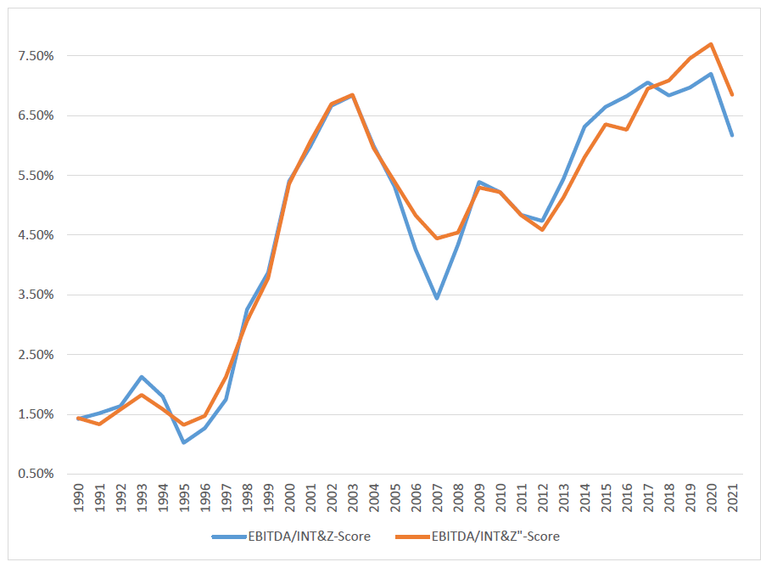
FRACTION OF ZOMBIE FIRMS — GLOBAL EVIDENCE
The figure shows the average fraction of zombie firms of the 20 largest GDP countries in the world from 1990 to 2021. A zombie firm is defined as a firm with a three-year moving average interest coverage ratio that is less than one and has either three-year average Z-score or Z”-score that is less than zero.
33

Slide 34
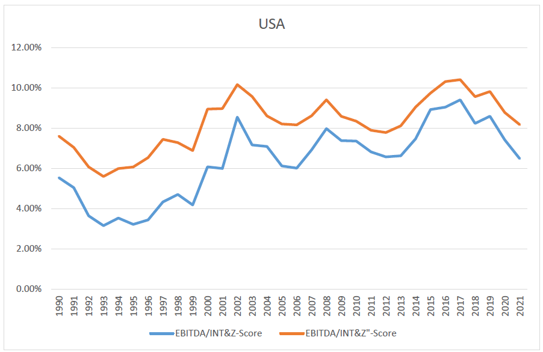
Ratio of Zombie Companies Based on
Interest Coverage Ratio <1.0 and Z-Score <0.0
Dual Filter Approach: U.S.A. 1990 - 2021
EBITDA/INT & Z-Score
EBITDA/INT & Z”-Score
34

Slide 35
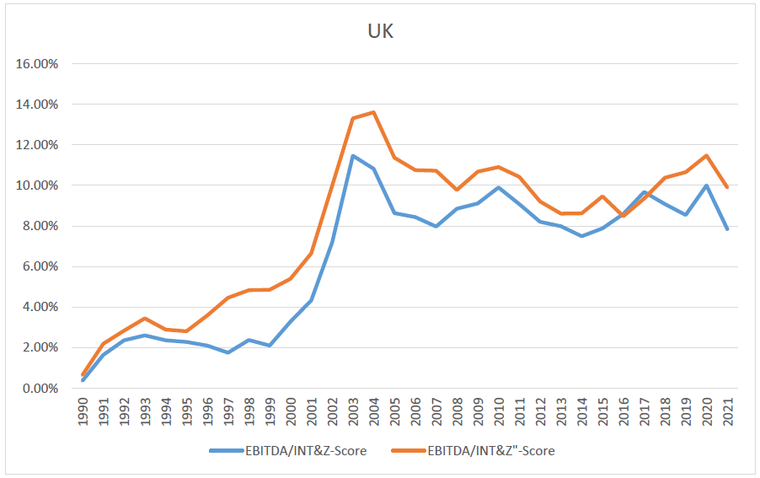
Ratio of Zombie Companies Based on
Interest Coverage Ratio <1.0 and Z-Score <0.0
Dual Filter Approach: UK 1990 - 2021
35

Slide 36
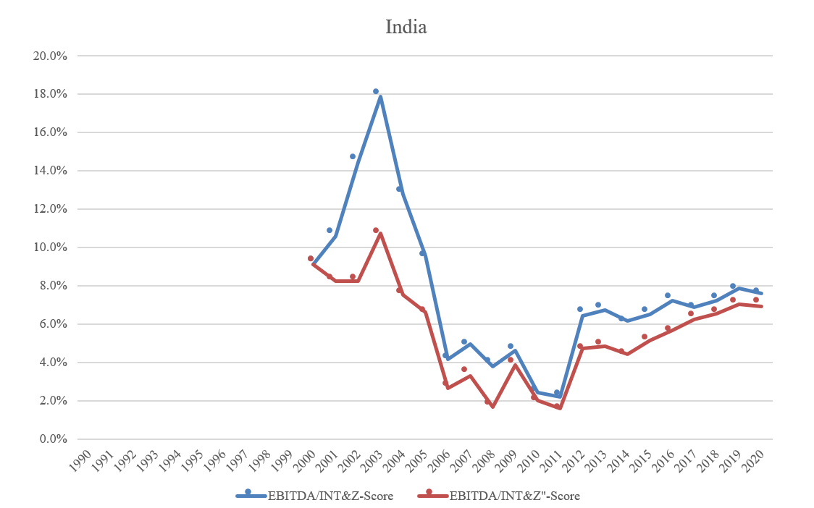
Ratio of Zombie Companies Based on
Interest Coverage Ratio <1.0 and Z-Score <0.0
Dual Filter Approach: India 1990 - 2020
36

Slide 37
DETERMINANTS OF ZOMBIE FIRM RATIOS OF LISTED COMPANIES –
BASED ON CROSS SECTIONAL & TIME SERIES REGRESSIONS
Results Are Controlled for GDP Growth
Determinant Variable. Impact (Association)
Cyclicality (-) - (Negative)
Firm Size. (+) - (Positive)
Sovereign rating (IV grade) (-) - (Negative)
Financing Channels (Debt Issuance) (+) - (Positive)
Creditor Rights & Debt Enforcement (-) - (Negative)
Bankruptcy Code Reforms Over Time (-) - (Negative)
37

Slide 38
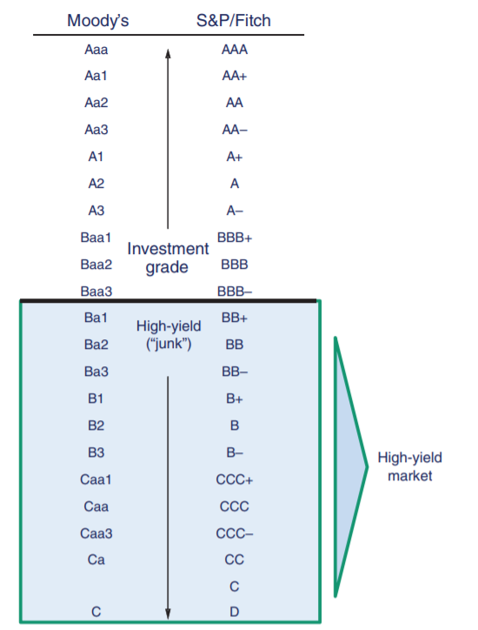
Major Agencies Bond Rating Categories
13

Slide 39
Size of the US High-Yield Bond Market:
1978 – 2022
Source: NYU Salomon Center estimates using Credit Suisse, S&P, Citi and BofA data
14
Notes:
Altman to send an up to 2019 chart.

Slide 40
U.S. Non-Finance firms Z-Score by S&P Bond Rating: 1992–2022
Rating | 2022 (No.) | 2019-2020 (No.) | 2015-2017 (No.) | 2011-2013 (No.) | 2004-2010 | 1996-2001 | 1992-1995
AAA/AA | 6.32 (20) | 4.74 (14) | 4.20 (14) | 4.13 (15) | 4.18 | 6.20* | 4.80*
A | 4.33 (99) | 4.03 (67) | 3.85 (55) | 4.00 (64) | 3.71 | 4.22 | 3.87
BBB | 3.63 (315) | 2.87 (222) | 3.10 (137) | 3.01 (131) | 3.26 | 3.74 | 2.75
BB | 3.13 (324) | 2.29 (270) | 2.45 (173) | 2.69 (119) | 2.48 | 2.81 | 2.25
B | 1.80 (242) | 1.22 (203) | 1.65 (94) | 1.66 (80) | 1.74 | 1.80 | 1.87
CCC/CC | 0.43 (34) | 0.47 (23) | 0.73 (4) | 0.23 (3) | 0.46 | 0.33 | 0.40
D | -0.24 (14) | -0.76 (54),# -0.42 (59)^ | -0.10 (16) | 0.01 (33) | -0.04 | -0.20 | 0.05
*AAA Only.
Sources: S&P CapitalIQ, Compustat Database, mainly S&P 500 firms, compilation by NYU Salomon Center, Stern School of Business.
-0.87 is mean and -0.50 is the median Z scores for the rating category D (2020 only).
15
Notes:
40

Slide 41
CORPORATE DEBT MARKET DEVELOPMENT IMPACT ON ZOMBIE RATIOS
(Based on New Issuance of Worldwide and U.S. High Yield Bonds)
7.3% of B Rated Firm Bonds Qualified As Zombies Over Time
28.0% of CCC/CC Rated Firm Bonds Qualified As Zombies
The Median EBITDA Interest Coverage Ratio of CCC (S&P) Rated Bonds in 2007-2009 was 1.1 and the Median EBITDA Interest Coverage Ratio of CCC Rated Bonds in 2022 was 0.9; hence about 50% of CCC companies did not cover their interest payments with their cash flows in recent years
41

Slide 42
IMPACT OF ZOMBIE FIRMS ON THE ECONOMY
(Congestion Regression Results)
A 1% INCREASE in Zombie Ratios In a Sample of Industrial Sectors Lead To LOWER Various Measures of Performance Amongst NON-ZOMBIE Firms In the Same Industrial Sector: Performance Measures Resulted In:
  1.5% DECREASE in Investment
  2.5% DECREASE In Employment
  1.0% DECREASE in Sales Growth
42

Slide 43
IMPACT OF MAJOR BANKRUPTCY CODE REFORMS ON ZOMBIE RATIOS
(Based On Recent Bankruptcy Code Reforms in 8 Countries)
Within 3 Years Of A Country's Major Bankruptcy Code Reform, Zombie Ratios DECREASED by 2 Percentage Points Relative To Their Historic Averages (Gradual Decrease over the 3 Years)
The Sample Countries' Zombie Ratios Were Fairly Constant and Indistinguishable From Other Countries in The Years Prior To The Reforms. Hence, We Conclude That The Reforms Were Not Due To High Zombie Ratios
43

Slide 44
Post-Zombie Fate: U.S. Zombie Firms: 1990-2021
Post-Zombie Fate | No. of Firms. | % of Total | Avg. Time (Years) After First Identified As Zombie
Bankrupt | 505 | 15.30% | 4.7
Delisted | 1,397 | 42.20% | 3.7
M&A | 1,039 | 31.40% | 5.5
Recovered | 365 | 11.10% | 3.9
Total Firms | 3,306 | 100.00% | -----
44
Sources: CRSP, Compustat, Worldscope, Capital IQ, Bankruptcy.Com

Slide 45
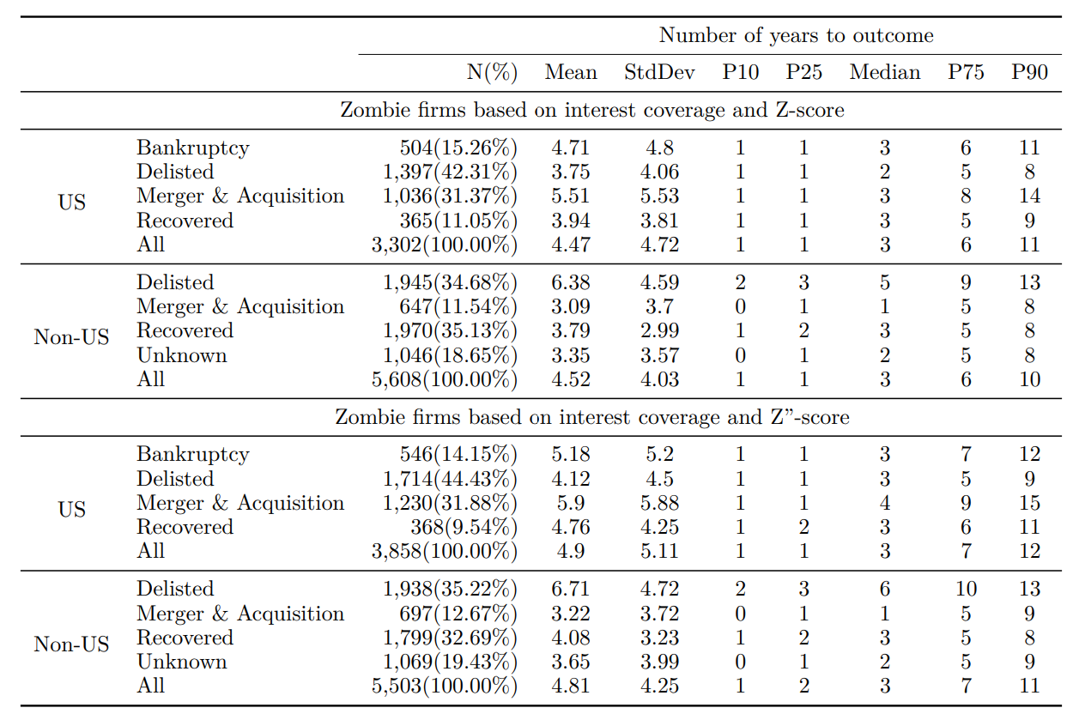
Outcomes of Zombie Firms
The table below displays the outcomes of zombie firms, categorized as bankruptcy (Chapter 11 or Chapter 7 filings in the United States), delisted, merger & acquisition, recovered, and unknown. It also reports the average years between when a company became a zombie firm and when it reached one of the outcomes. It is considered that a company is recovered from zombie status if it is no longer identified as a zombie by interest coverage and Z-score or Z”-score.

Slide 46
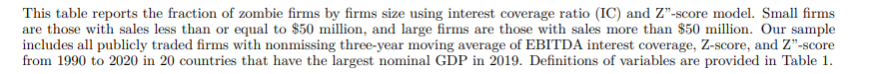
ZOMBIE FIRMS AROUND THE WORLD
By Firm Size in 2019
 |  | Small-Medium Firms (SMEs) |  |  |  | Large Firms |  |  | Fraction of
Nation | 2019 GDP Rank | N. Firms | IC | IC & Z" |  | N. Firms | IC | IC & Z" | SMEs
United States | 1 | 315 | 60.00% | 42.54% |  | 1641 | 9.81% | 3.53% | 16.10%
China | 2 | 369 | 34.42% | 10.84% |  | 3448 | 8.79% | 0.87% | 9.69%
Japan | 3 | 352 | 17.33% | 2.27% |  | 2356 | 1.95% | 0.13% | 13.00%
Germany | 4 | 136 | 39.71% | 13.24% |  | 315 | 7.30% | 1.27% | 30.16%
India | 5 | 1279 | 23.46% | 9.38% |  | 1117 | 9.76% | 4.30% | 53.38%
United Kingdom | 6 | 367 | 55.59% | 24.80% |  | 536 | 7.84% | 0.93% | 40.64%
France | 7 | 192 | 64.06% | 28.13% |  | 305 | 5.25% | 0.66% | 38.63%
Italy | 8 | 83 | 22.89% | 8.43% |  | 190 | 6.84% | 1.05% | 30.40%
Brazil | 9 | 17 | 64.71% | 52.94% |  | 128 | 14.84% | 3.13% | 11.72%
Canada | 10 | 1257 | 60.46% | 40.89% |  | 404 | 17.33% | 3.96% | 75.68%
Russian Federation | 11 | 19 | 42.11% | 10.53% |  | 126 | 7.14% | 3.17% | 13.10%
Korea, Rep | 12 | 632 | 48.58% | 10.28% |  | 1422 | 10.48% | 0.70% | 30.77%
Australia | 13 | 969 | 56.86% | 32.92% |  | 350 | 13.43% | 4.00% | 73.46%
Spain | 14 | 35 | 31.43% | 11.43% |  | 89 | 10.11% | 0.00% | 28.23%
Mexico | 15 | 0 | 0.00% | 0.00% |  | 83 | 1.20% | 0.00% | 0.00%
Indonesia | 16 | 166 | 22.89% | 4.22% |  | 304 | 9.54% | 2.63% | 35.32%
Netherlands | 17 | 18 | 50.00% | 22.22% |  | 69 | 10.14% | 4.35% | 20.69%
Saudi Arabia | 18 | 25 | 24.00% | 0.00% |  | 104 | 7.69% | 0.00% | 19.38%
Turkey | 19 | 117 | 35.04% | 8.55% |  | 149 | 11.41% | 3.36% | 43.98%
Switzerland | 20 | 23 | 73.91% | 39.13% |  | 145 | 8.28% | 0.69% | 13.69%
Average |  | 6371 | 41.37% | 18.64% |  | 13281 | 8.96% | 1.94% | 29.90%
Weighted Average |  |  | 44.52% | 22.21% |  |  | 8.21% | 1.63%
46

Slide 47
IMPACT OF COVID-19 PANDEMIC
ON GLOBAL ZOMBIE RATIOS
Very Small Impact Overall on Global Zombie Ratios
  Global Average Change of Zombie Ratio from 2019 to 2020 - + 0.12%
  10 Countries Had An Increase of Zombies
  8 Countries Had A Decrease of Zombies
  2 Countries Had No Change of Zombies
Reasons For Small Change During the Pandemic?
47

Slide 48
CONCLUDING REMARKS
"Zombie firm trends are clearly cyclical with spikes in zombies as economic growth declines."
We Propose a Two-Step, Dual-Filter Measure for Identifying and Quantifying Zombie Firms on a Global and Country Basis
The Dual-Filter Approach Involves a 3-Year Moving Average Cash-Flow Interest Coverage Ratio <1.0 AND A High Default Probability Forecast (Z-Scores < 0/0)
We find That The Average Proportion of Publicly Traded Firms from the 20 Largest Global Economies Increased Significantly in The Past 30 Years From 1.5% in 1990 to About 7.0% in 2021. Is this a Trivial Amount, or Not?
U.S. Zombie Firms Increased from About 6.0% of Listed Companies in 1990 to About 8% in 2021; Countries like Japan, China and Germany Had Considerably Lower Zombie Ratios
Smaller Firms Are More Likely To Be Zombies than Larger Companies, Impacting Certain Countries More Than Others, eg. Australia and Canada
Global Zombieism Did not Increase Much During The COVId-19 Pandemic From 2019 to 2020 but Did Decrease in 2021 as the World’s Economies Recovered from the Pandemic Recession"
Our Results Have Important Implications For Policy Makers, Legislators, And Financial Economists
48

