Slide 1






Slide 2

Mind the Gap: The Difference between US and European Loan Rates
Presenter: Anthony Saunders (NYU)
Authors: Tobias Berg (Bonn), Anthony Saunders (NYU), Sascha Steffen (ESMT), Daniel Streitz (Bonn)
Warsaw, 27 April 2017

Slide 3
Motivation: Pricing puzzle
Pricing puzzle by Carey and Nini (JF 2007): Loan spreads in Europe about 20% smaller than in the U.S.
Significant implications: Corporate finance, Macroeconomics, Competition policy
Data: Syndicated loans 1992-2002
No explanation: credit risk, loan or borrower characteristics
Suggested explanation: Limited competition in the U.S. coupled with home bias of lenders

Slide 4
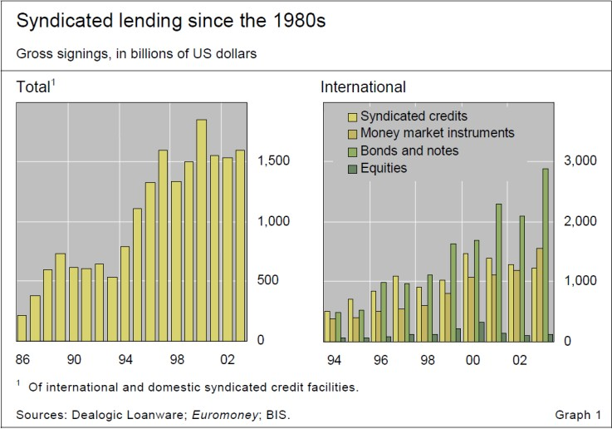
Motivation: Syndicated loan market is important

Slide 5
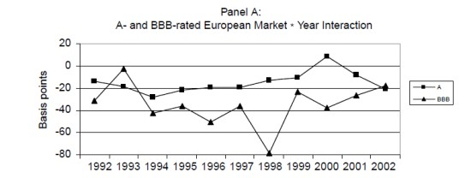
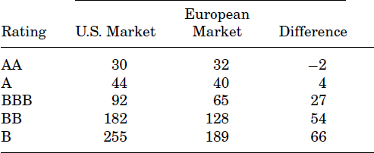
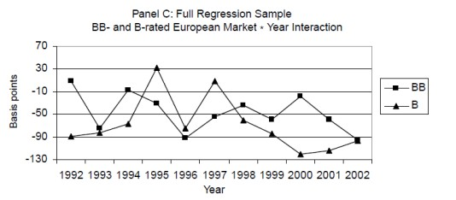
Motivation: Carey/Nini pricing puzzle

Slide 6
Motivation: Carey/Nini pricing puzzle
Carey/Nini results are robust to:
Controls (rating, year, loan characteristics, loan type, loan
purpose, industries, government ownership of firms)
USD-denominated vs. full sample
Pre-1998 vs. Post-1999 (beginning of Euro)
Different standards by rating agencies
Legal regime / Bankruptcy regimes / Loss given defaults
Ex-post monitoring
Existence of state-owned and cooperative banks
Tax effects
Liquidity effects

Slide 7
Lines of attack
Loan type / Fees: Term loans (1/3) versus credit lines (2/3)
  Disbursement of full loan amount versus contingent liquidity: complex
pricing structure of credit lines
Bank vs. bond market
  Europe: bank-based economy (300%/100% bank-assets to GDP)
  Implies potential selection effects in syndicated loan markets
Institutional investors: Competition from non-bank lenders, in particular for term loans
Supply of loans by foreign banks
Pre-view:
Credit lines: No pricing puzzle, only different pricing structure
Term loan: Selection effect explains ~50% of pricing puzzle, institutional investors and foreign bank loan supply removed puzzle until 2007, and explains variation in puzzle over entire period

Slide 8
Data
Data sources
Dealscan
Ratings from S&P
(Compustat)
Data filters (as in Cary/Nini)
Rated firms only (i.e., firms with an “objective” measure of credit risk)
Only loans to US and European firms
Sample period
– 1992-2002
– Extended to 2014

Slide 9
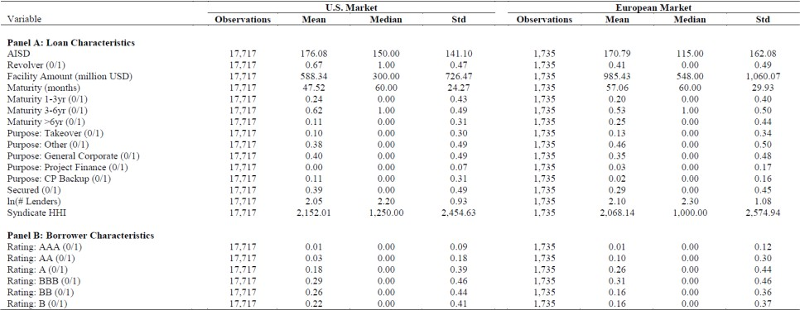
Data: Descriptives

Slide 10
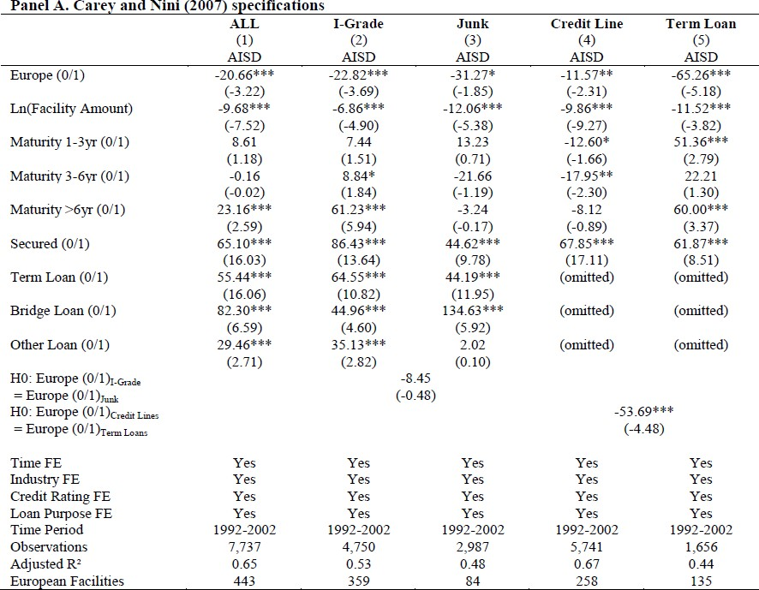
Results: Benchmark Regression

Slide 11
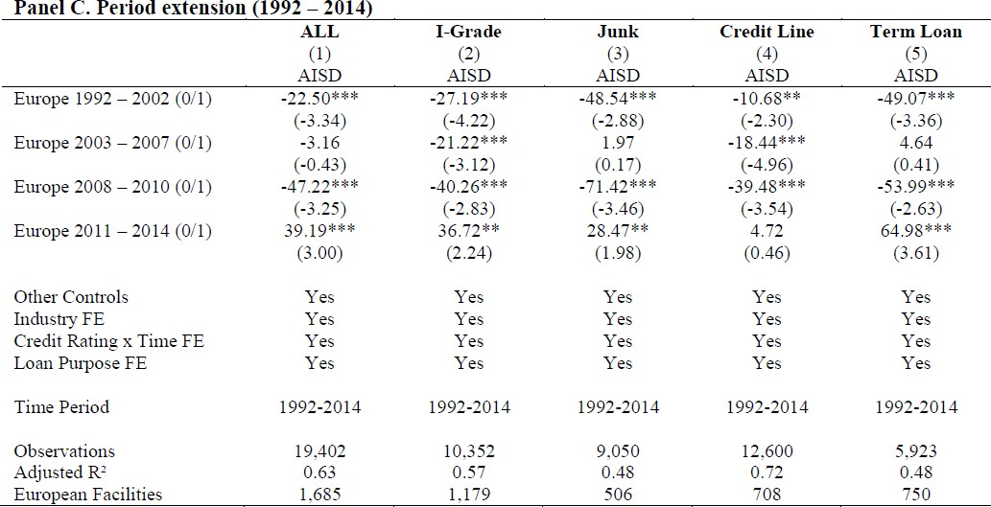
Results: Extension to 2014

Slide 12
Line of attack 1: Loan types and fees

Slide 13
Fees: Example
Meredith Corp, 16Jun2010,3-year USD 150mn credit line
Upfront fee: 50 bps
$0.75 mn
Undrawn amount
Drawn amount
Commitment Fee:
37.5 bps
Spread: 250 bps
up to
$0.6 mn
p.a.
up to
$3.7 mn p.a.
AISU
AISD
13

Slide 14
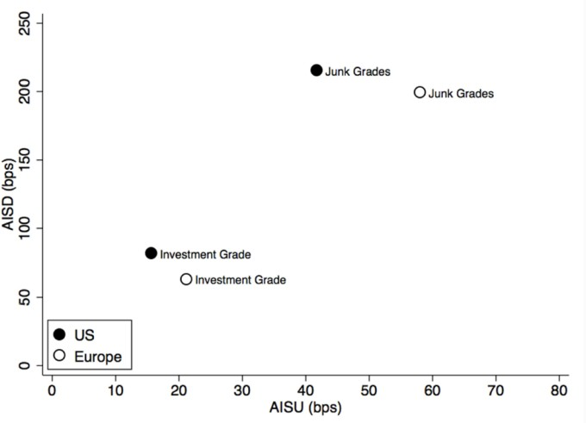
Fees are higher in Europe: Univariate evidence

Slide 15
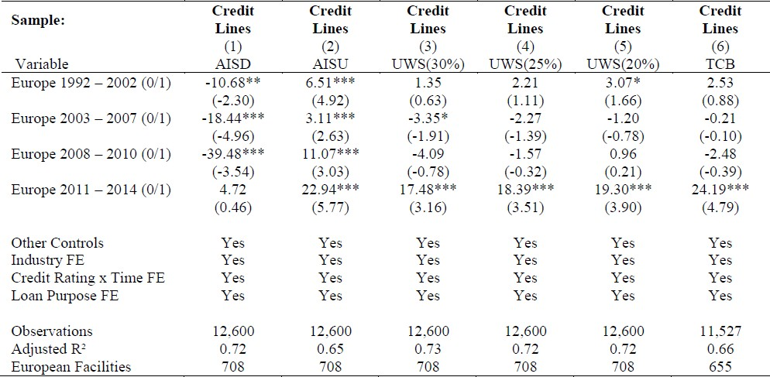
Fees are higher in Europe: Multivariate evidence

Slide 16
The “Pricing Strucutre” puzzle
New puzzle: Why is pricing structure different in U.S. vs. Europe?
Two observations
  High AISD / Low AISU contract („U.S.-type“) provides disincentives to draw down the line
  Usage of credit lines is more cyclical in the U.S. (higher sensitivity of usage rates to performance)
Idea: U.S. lenders need to shield themselves from draw-downs in bad times

Slide 17
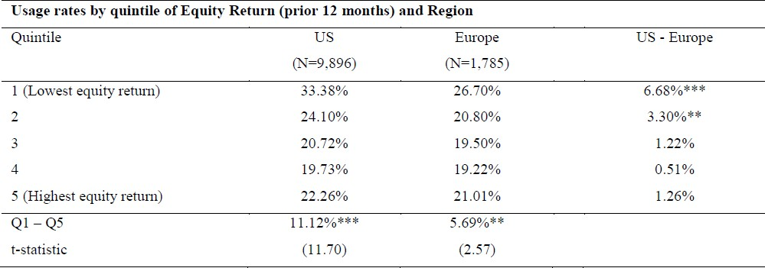
Pricing structure puzzle: Univariate evidence

Slide 18
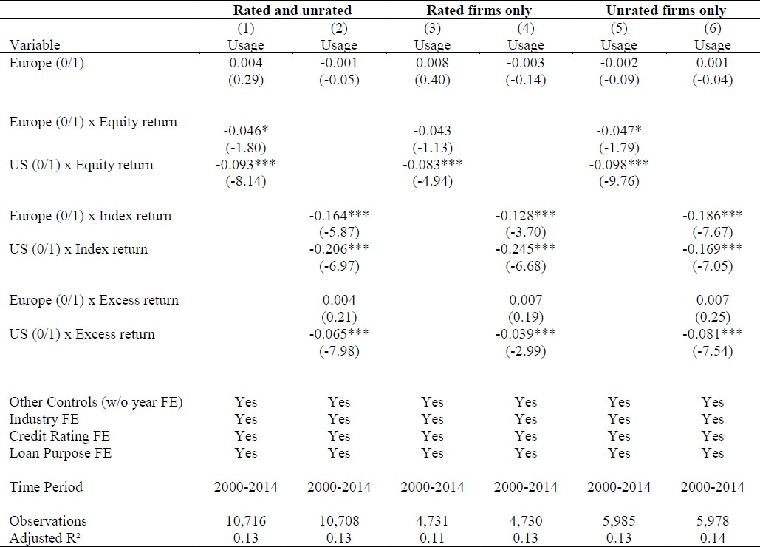
Pricing structure puzzle: Multivariate evidence

Slide 19
Line of attack 2: Bank vs. bond market

Slide 20
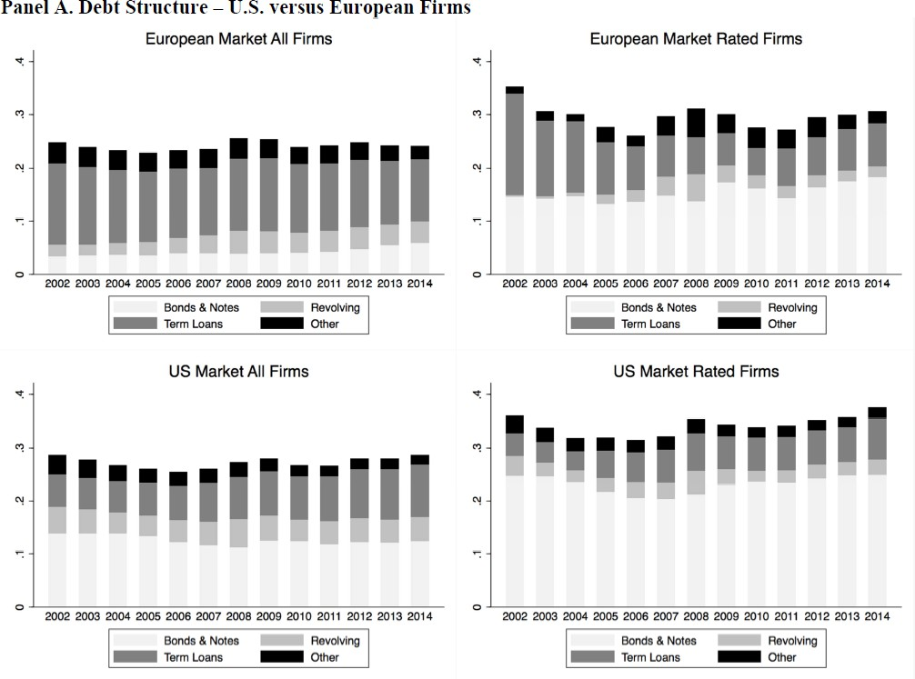
Debt structure: Europe vs. U.S.

Slide 21
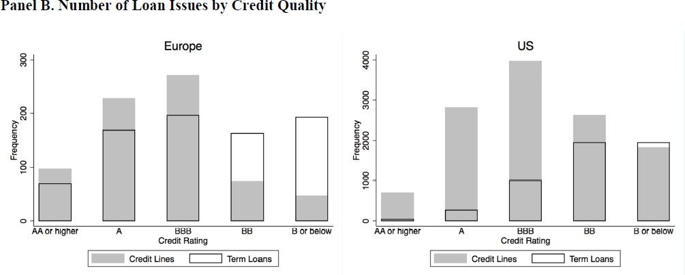
Debt structure: Europe vs. U.S.

Slide 22
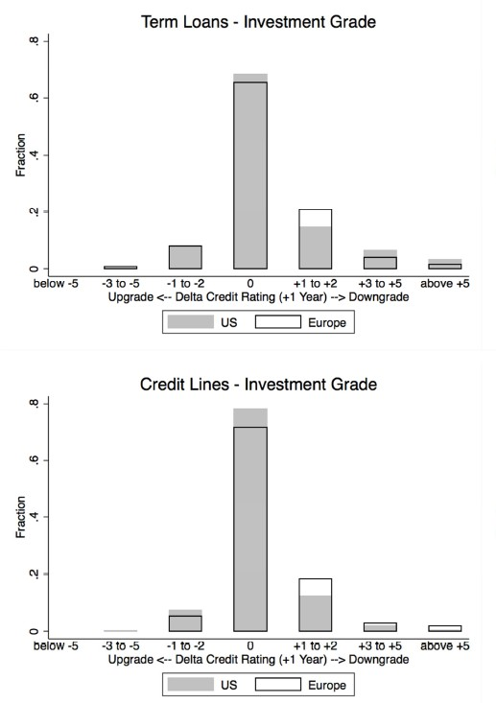
Post-issuance performance: Europe vs. U.S. (univariate)
„Falling angels“
U.S. investment grade term loans: 0.5 notches worse rating devlopment on average relative to European borrowers

Slide 23
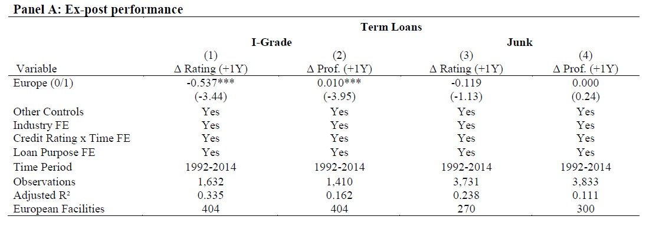
Post-issuance performance: Europe vs. U.S. (multivariate)

Slide 24
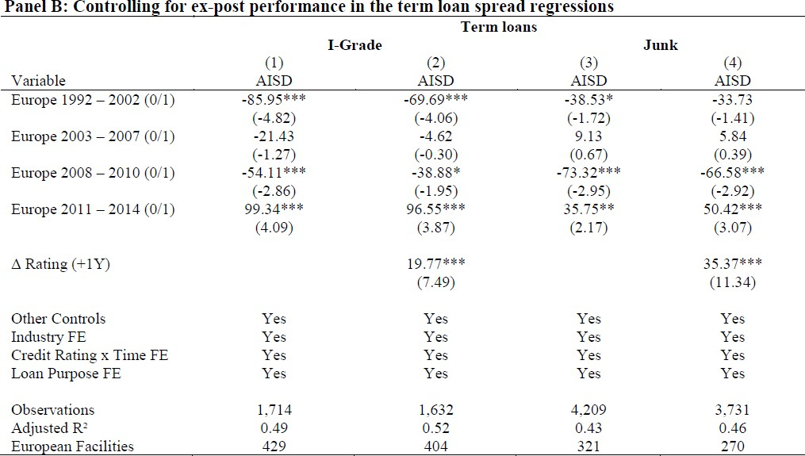
Post-issuance performance: Effect on pricing puzzle

Slide 25
Line of attack 3: Institutional investors and foreign bank lending

Slide 26
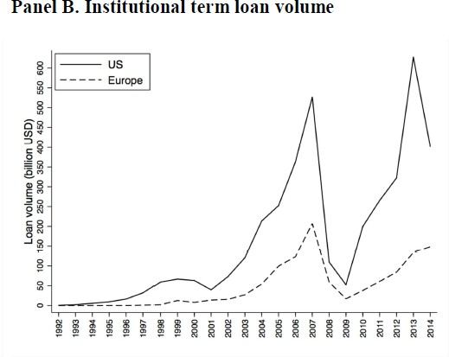
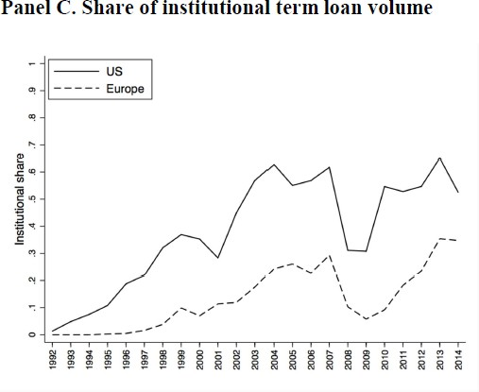
Institutional investors increasingly important in U.S.

Slide 27
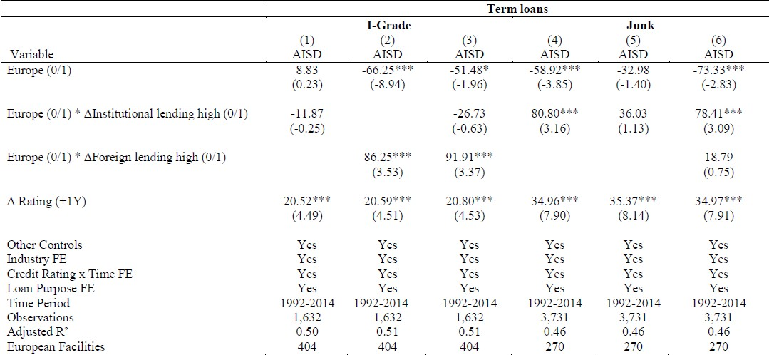
Institutional and foreign bank lending

Slide 28
Conclusion
Credit lines
Accounting for unused fees (AISU) fully explains the pricing puzzle for lines of credit. While European borrowers pay a significantly lower AISD, they also pay a significantly higher AISU.
Rationale for differences in pricing structure: Cyclicality of draw-down rates
Term loans
Selection effects due to larger (junk) bond market in the U.S.
Institutional demand pressure since 2002 removed pricing gap
Institutional and foreign bank supply associated with variations in loan pricing difference between U.S. and Europe

Slide 29
Appendix

Slide 30
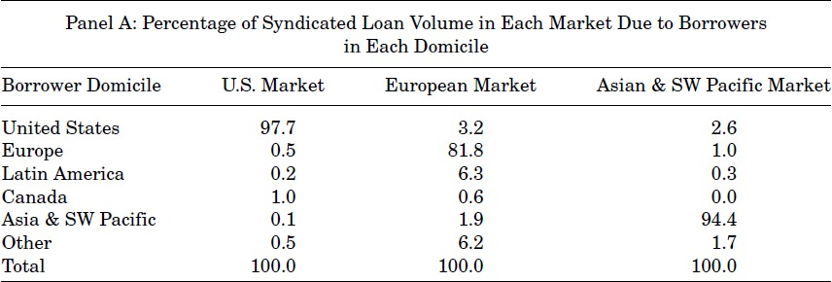
Market and borrower domicile

Slide 31
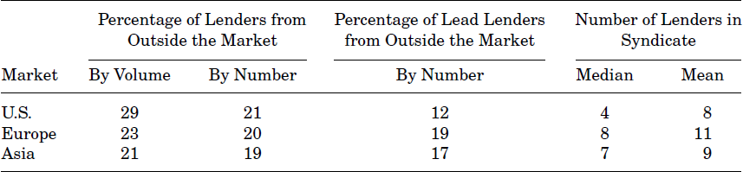
Market and lender domicile

